Slide 1
Amrita Online
Admissions Portal
LET YOUR SUCCESS STORY START WITH AMRITA
Directorate of Admissions
Amrita Vishwa Vidyapeetham
www.amrita.edu/btech

Slide 2
Registered Candidate
New Candidates
Already Registered Candidate can LOGIN with your Registered Email ID, Password
Sign in with your Name, Valid Email id Mobile number & Set password for Future Correspondence
Sign In
www.amrita.edu/btech

Slide 3
Application Stages
5
1
Personal Information
2
Application Details
3
Payment
4
Academic Details*
5
Upload Required Documents *
* Details to be entered after publication of the 12th / HSC result
www.amrita.edu/btech

Slide 4
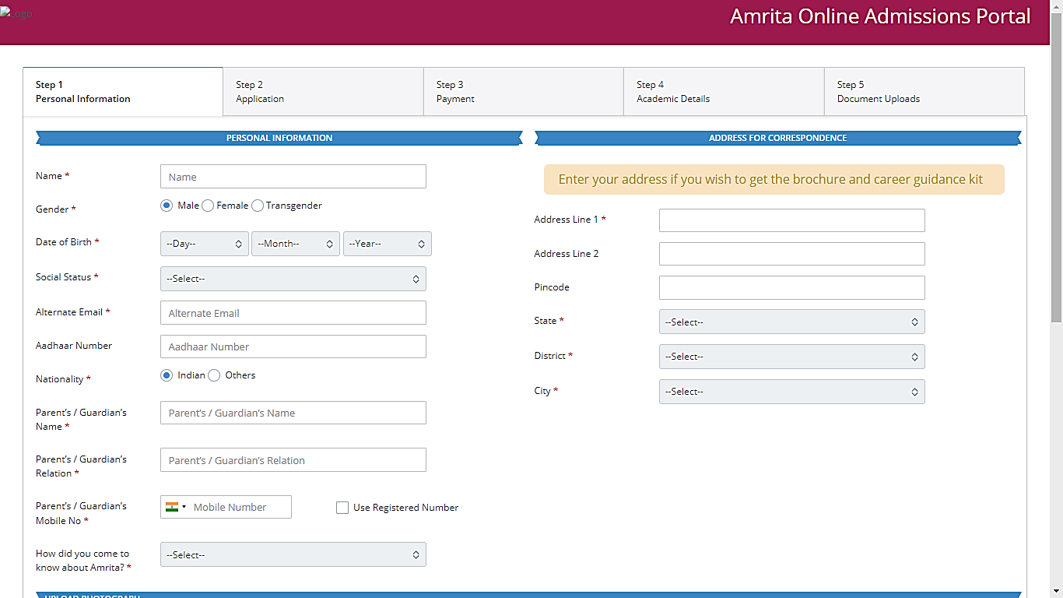
Step 01 - Personal Information
Enter Your Name as per your SSLC / Intermediate.
www.amrita.edu/btech

Slide 5
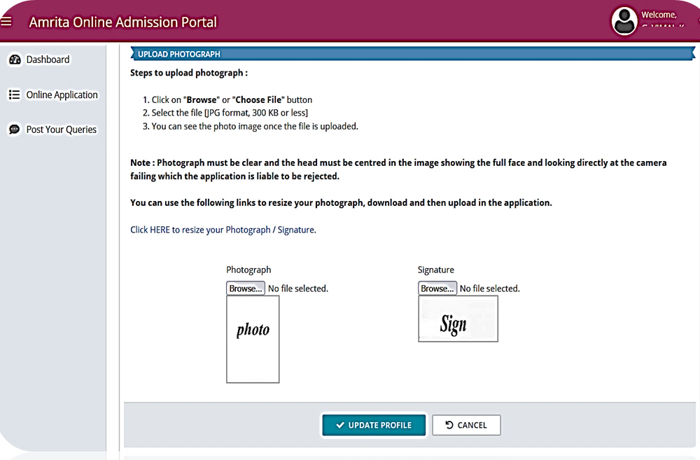
Upload Photo & Signature
Upload recent colour photograph and signature
Image resize link available in the page
www.amrita.edu/btech

Slide 6
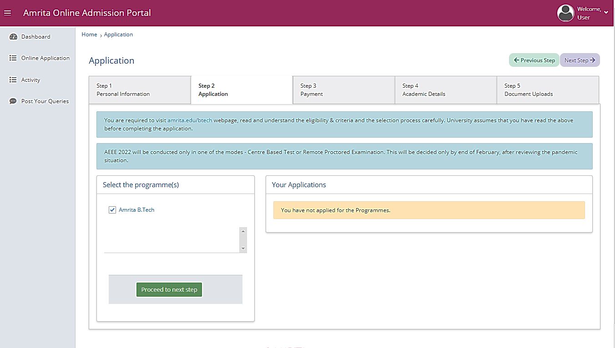
Step 02 - Application
Candidates select “B.Tech Programme”
Other programmes can also be selected
Read the instructions for the selected programme(s) in consent webpage
www.amrita.edu/btech

Slide 7
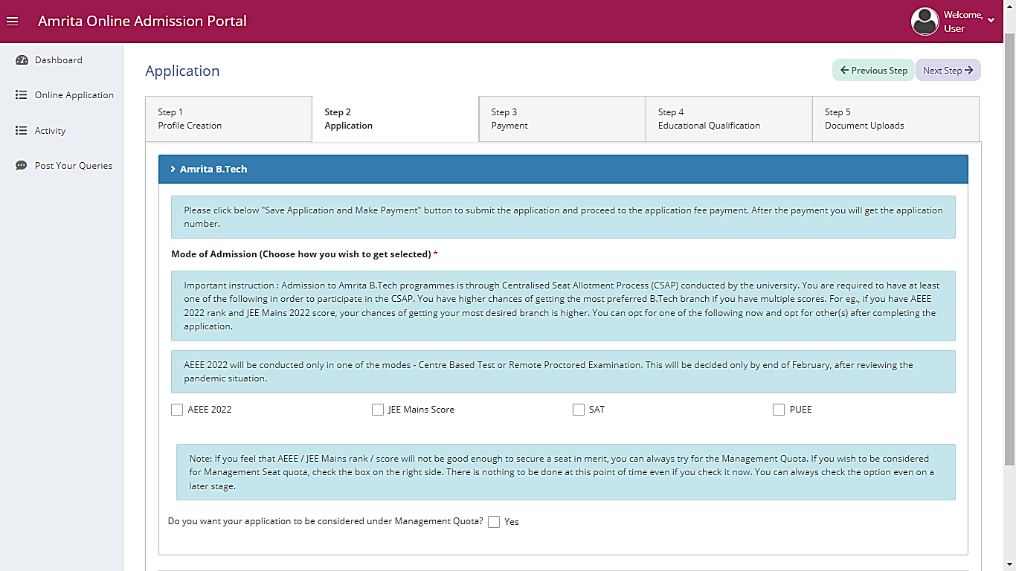
Mode of Admission
Candidates can select multiple Admission option for B.Tech Programme(s)
Here candidate can submit the willingness for management quota admission.
www.amrita.edu/btech

Slide 8
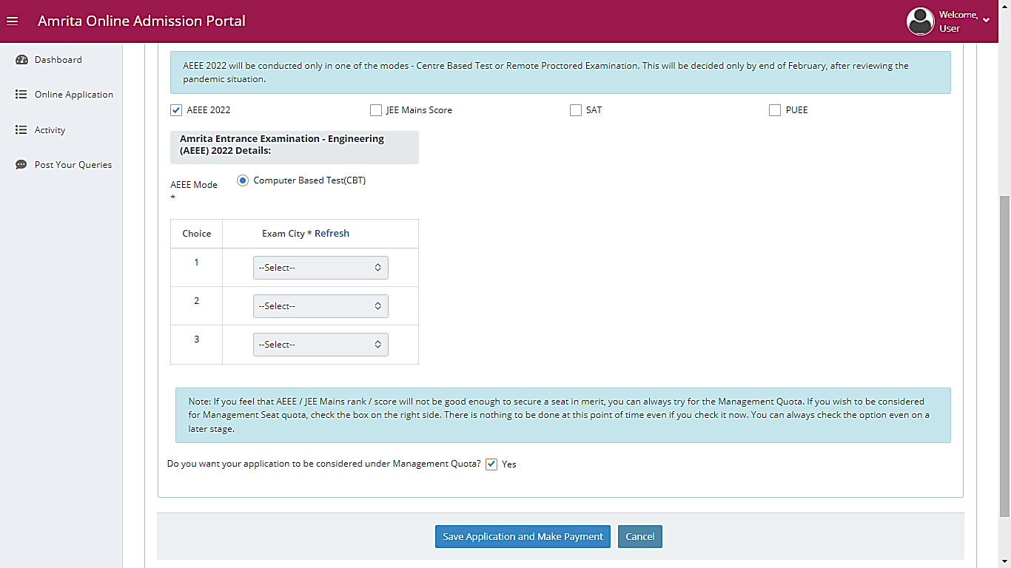
Application & Exam Mode
AEEE
CBT Exam Mode.
Applicant needs to provide their 3 exam city option here.
www.amrita.edu/btech

Slide 9
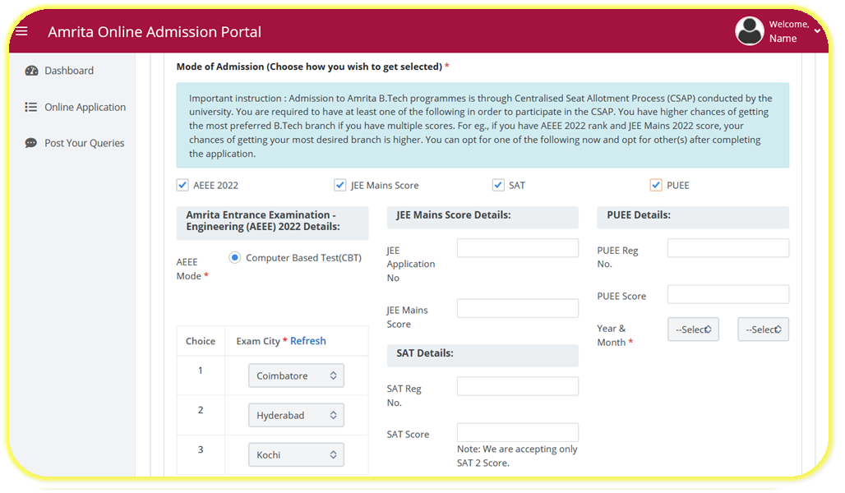
Application & Exam Mode
Applicants can enter the details here based on the options selected. Candidates can also enter the option later after making the payment. If the details are not available now, it can be entered before the Amrita B Tech CSAP.
www.amrita.edu/btech

Slide 10
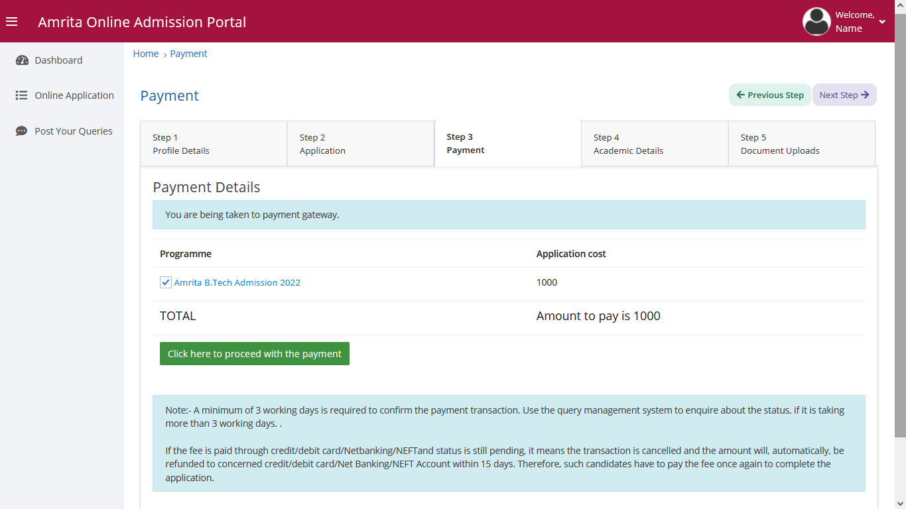
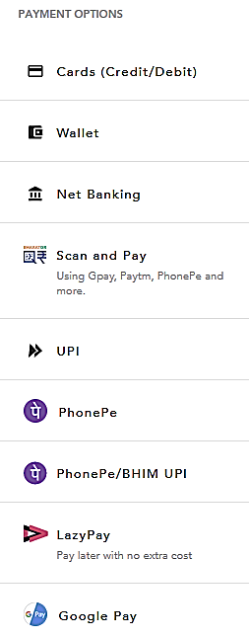
Step 03 - Payment
Make payment for selected Programme(s)
www.amrita.edu/btech

Slide 11
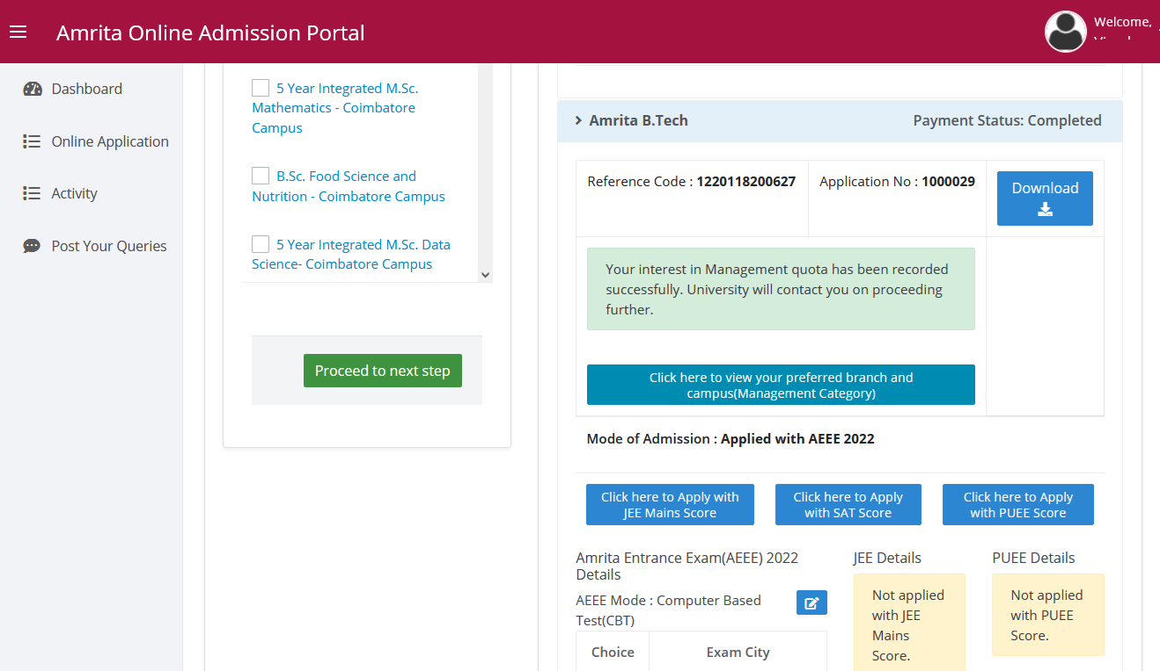
Application Download
Application Download:
After Complete the Payment Candidate can download the application form
www.amrita.edu/btech

Slide 12
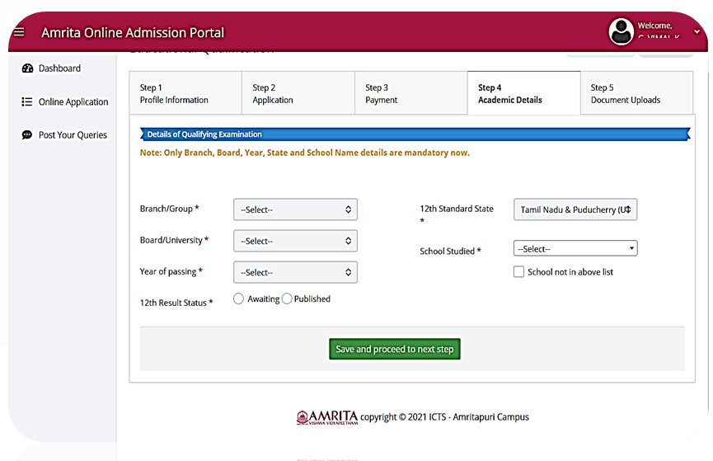
Step 04 - Academic Details
After publication of the 12 / HSC Result
Academic Details :
Enter the previous class / Institution academic details
www.amrita.edu/btech

Slide 13
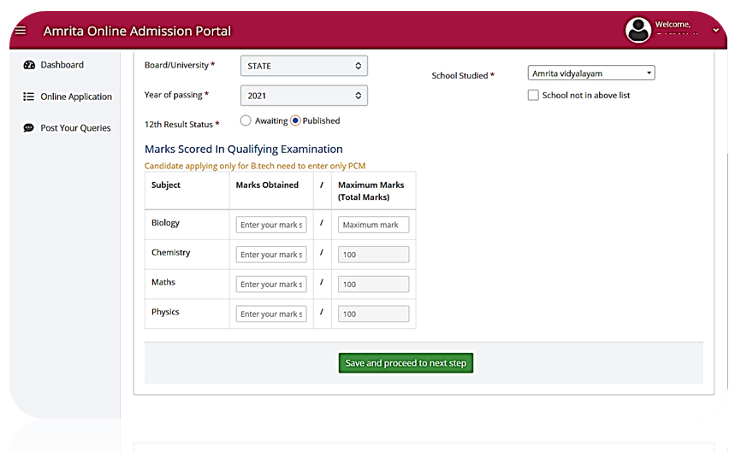
Marks: Physics, Chemistry, Maths
After publication of the 12th / HSC Exam Result
Candidate should submit their available Academic Marks
(Physics, Chemistry
Mathematics
Biology) to the selected programme(s)
www.amrita.edu/btech

Slide 14
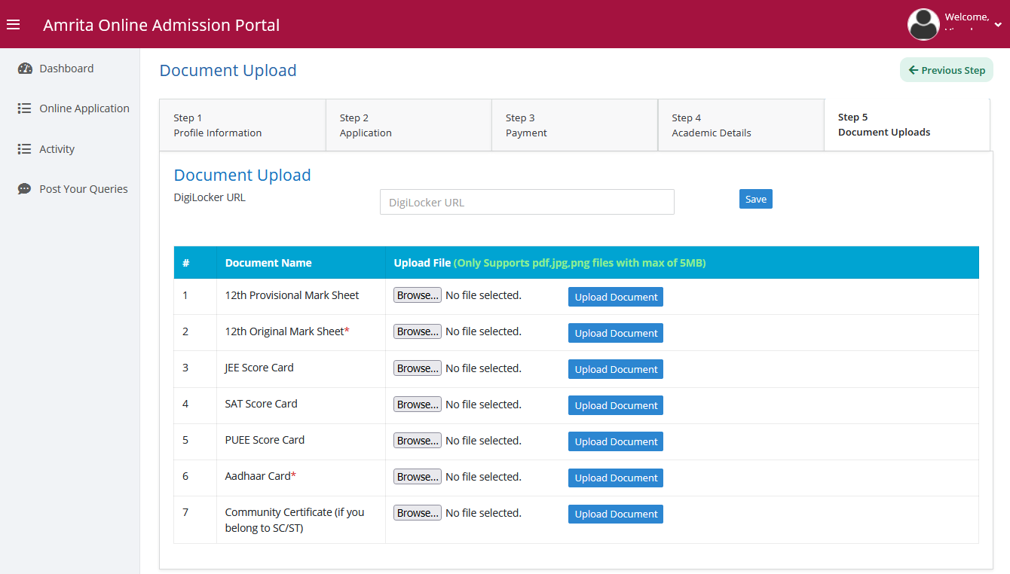
Step 05 - Upload Documents
After publication of the 12th / HSC
Exam Result
Necessary documents needs to be uploaded in the stage
www.amrita.edu/btech

Slide 15
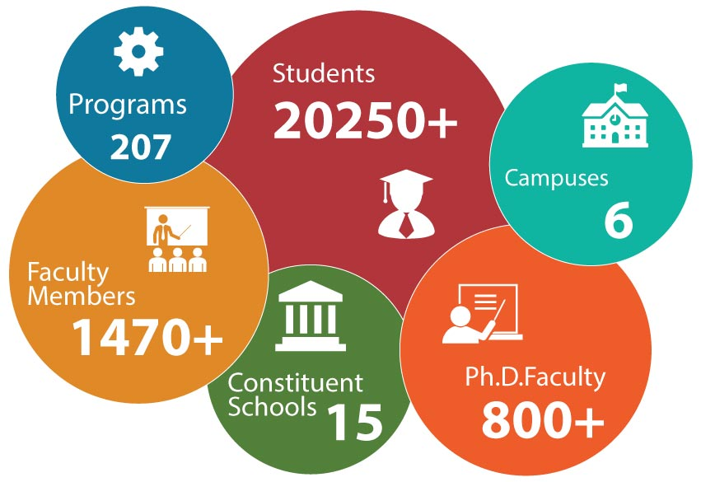
Enquiries
044-462 76066 (Toll Free)
Time : 9 AM to 6 PM
(Monday to Saturday except public holidays)
LET YOUR SUCCESS STORY
START WITH
AMRITA
btech@amrita.edu
Directorate of Admissions
E-105, Admissions Office
Academic Block 3,
Amrita Vishwa Vidyapeetham
Amritanagar P.O, Ettimadai,
Coimbatore - 641112
Tamilnadu

